Slide 1
Introduction to Requirements Engineering & Requirements Engineering Process
By: Fariha Shaikh

Slide 2
WHAT IS REQUIREMENT ENGINEERING?
It is a systematic approach to identifying, eliciting, analyzing, specifying, validating, and managing the needs and expectations of stakeholders for a software system.
To guarantee the effective creation of a software product, the requirements engineering process entails several tasks that help in understanding, recording, and managing the demands of stakeholders.

Slide 3
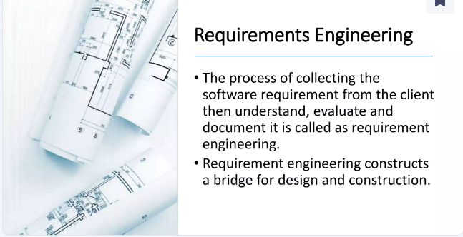

Slide 4
The process of establishing the services that the customers requires from the system and the constraints under which it operate and is developed.
A requirement mandates that something be accomplished, transformed, produced or provided.

Slide 5
USER & CUSTOMER
The terms "customer" and "user" are often used interchangeably, but they have distinct meanings, especially in software engineering and product development.
Customer Definition: A customer is the person or organization that pays for or commissions a product or service. They are the entity that makes the purchasing decision.
Role:
In many cases, the customer may specify requirements, approve designs, and provide funding.
The customer might be involved in the decision-making process and have a significant influence on the product's features and functionality.

Slide 6
Example:
If a company hires a software development firm to build a custom application, the company is the customer.
If you purchase a smartphone, you are the customer.
User Definition: A user is the individual or group of individuals who actually use the product or service. They interact with the system to achieve a specific goal or perform tasks.
Role:
Users provide feedback on the usability and functionality of the product.
They are the end recipients of the product's benefits and are concerned with how the product performs in practice.
Users might not have any say in the purchase decision or in defining the product's features but are critical for the product’s success.

Slide 7
Example:
In the case of the custom application mentioned earlier, employees of the company who use the application are the users.
For the smartphone you purchased, you are the user when you operate it.

Slide 8
IMPORTANCE OF REQUIREMENT ENGINEERING
Requirements engineering is the first and critical aspect of software development.
It ensures that the software meets the needs of its users, and is delivered on time, within budget, and to the required quality standards.
It lays the groundwork for a successful project.
Reduces the risk of project failure, facilitates better planning and communication, and supports quality assurance. By investing time and effort in proper requirements engineering, organizations can avoid many common pitfalls in software development and increase the likelihood of delivering a successful product.

Slide 9
CLASSIFICATION OF REQUIREMENTS
Requirements in software engineering are typically classified into different types based on their purpose, nature, and the aspects of the system they describe.
Functional Requirements: These describe what the system should do, specifying the functions, features, and behavior that the software must support.
Examples:
The system must allow users to log in using their email and password.
The system must generate a monthly sales report.

Slide 10
2) Non-Functional Requirements: These describe how the system performs certain functions, focusing on the quality attributes of the system such as performance, usability, reliability, and security.
3) User Requirements: These describe the needs and expectations of the end users of the system.
4) System Requirements: These are detailed requirements that describe the system's technical specifications. They include both hardware and software requirements that the system must meet.
Subtypes: Hardware Requirements: Define the physical components needed. Example: The system must run on servers with at least 16GB of RAM.
Software Requirements: Define the software environment needed. Example: The application must be compatible with Windows and Linux operating systems.

Slide 11
Network Requirements: Define the network conditions the system must operate under. Example: The system must function over a network with latency up to 100ms.
5) Domain Requirements: These are specific to the domain in which the system operates and are often derived from the nature of the domain itself.

Slide 12
REQUIREMENTS CHARACTERISTICS:
When gathering and defining requirements for a software project, it's important to ensure that the requirements possess certain characteristics that make them effective and useful. The most common and essential characteristics of good requirements are:
1) Correctness: The requirement must accurately reflect the needs and desires of the stakeholders.
2) Completeness: The requirement should include all necessary information, covering every aspect of what is needed.

Slide 13
3) Clarity (Unambiguity): The requirement must be clearly stated, using language that is precise and unambiguous, so that it is easily understood by all stakeholders.
4) Consistency: The requirement should not conflict with other requirements and should be aligned with the project objectives.
5) Verifiability: The requirement must be stated in a way that allows it to be tested and verified during the development process.
6) Feasibility: The requirement must be realistic and achievable within the given time, budget, technology, and resources.

Slide 14
Requirements Engineering Process
The process of RE varies widely depending on the application domain, the people involved, and the organization developing the requirements.
However, there are several generic activities common in all processes.
Feasibility Study
Requirements elicitation
Requirements specification
Requirements for verification and validation
Requirements management

Slide 15
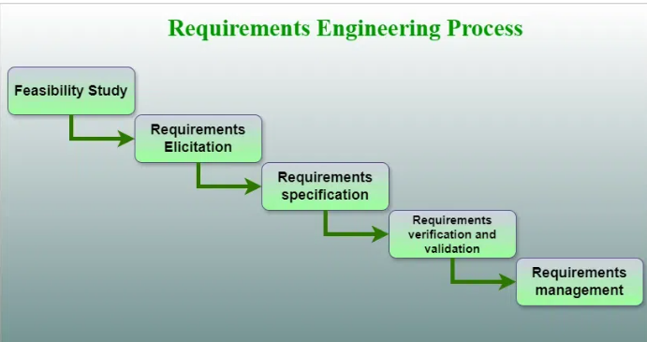

Slide 16
1) Feasibility Study:
The objective behind the feasibility study is to create the reasons for developing software that is acceptable to users, flexible to change and conformable to established standards.
Key Aspects of a Feasibility Study:
Technical Feasibility: Assesses whether the technology and resources needed to develop the system are available and capable of meeting the requirements.
Key Questions:
Do we have the technology to implement the requirements?
Are the technical skills and expertise available within the team?
Can the system be integrated with existing technologies and infrastructure?

Slide 17
b) Economic Feasibility: Decides whether the necessary software can generate financial profits for an organization.
Key Questions:
What are the projected costs of development, implementation, and maintenance?
c) Operational Feasibility: Examines whether the organization can operate the new system and whether it will be accepted by users.
Key Questions:
Can the organization support the system operationally?
Will the system be accepted by its intended users?
Does the organization have the resources (human, infrastructure, etc.) to operate the system effectively?

Slide 18
2) Requirements Elicitation:
Also known as Gathering of requirements. It is related to the various ways used to gain knowledge about the project domain and requirements. The various sources of domain knowledge include customers, business manuals, the existing software of the same type, standards, and other stakeholders of the project.
Several techniques can be used to elicit requirements, including:
Interviews: These are one-on-one conversations with stakeholders to gather information about their needs and expectations.
Surveys: These are questionnaires that are distributed to stakeholders to gather information about their needs and expectations.
Focus Groups: These are small groups of stakeholders who are brought together to discuss their needs and expectations for the software system.

Slide 19
Observation: This technique involves observing the stakeholders in their work environment to gather information about their needs and expectations.
Prototyping: This technique involves creating a working model of the software system, which can be used to gather feedback from stakeholders and to validate requirements.
It’s important to document, organize, and prioritize the requirements obtained from all these techniques to ensure that they are complete, consistent, and accurate.
3) Software Requirement Specification:
Software requirement specification is a kind of document which is created by a software analyst after the requirements collected from the various sources - the requirement received by the customer written in ordinary language. It is the job of the analyst to write the requirement in technical language so that they can be understood and beneficial by the development team.

Slide 20
The models used at this stage include ER diagrams, data flow diagrams (DFDs), function decomposition diagrams (FDDs),
The goal of this step is to create a clear and comprehensive document that describes the requirements for the software system. This document should be understandable by both the development team and the stakeholders.
4) Requirements Verification and Validation:
To ensure that the documented requirements accurately reflect the needs of stakeholders and are feasible to implement.

Slide 21
Verification: It refers to the set of tasks that ensures that the software correctly implements a specific function.
Validation: It refers to a different set of tasks that ensures that the software that has been built is traceable to customer requirements.
If requirements are not validated, errors in the requirement definitions would propagate to the successive stages resulting in a lot of modification and rework. The main steps for this process include:
The requirements should be consistent with all the other requirements i.e. no two requirements should conflict with each other.
The requirements should be complete in every sense.
The requirements should be practically achievable.

Slide 22
Verification is checking that the requirements are complete, consistent, and accurate. Validation is the process of checking that the requirements meet the needs and expectations of the stakeholders.
It is not a one-time process, but it should be integrated and continue throughout the software development process or Software development life-cycle and even in the maintenance stage.
5) Requirements Management:
Requirements management is the process of managing the requirements throughout the software development life cycle, including tracking and controlling changes, and ensuring that the requirements are still valid and relevant. The goal of requirements management is to ensure that the software system being developed meets the needs and expectations of the stakeholders and that it is developed on time, within budget, and to the required quality.

Slide 23
Several key activities are involved in requirements management, including:
Tracking and controlling changes: This involves monitoring and controlling changes to the requirements throughout the development process.
Communication: This involves ensuring that the requirements are communicated effectively to all stakeholders and that any changes or issues are addressed promptly.
Version Control: Maintaining versions of the requirements documents to track changes over time.
Monitoring and reporting: This involves monitoring the progress of the development process and reporting on the status of the requirements.

Slide 24
Conclusion:
The Requirements Engineering process is iterative and often involves revisiting earlier phases as new information is discovered or as the project evolves. By following this structured approach, organizations can ensure that their software projects are based on well-understood, clearly documented, and carefully managed requirements, reducing the risk of project failure and increasing the likelihood of delivering a successful product.

Slide 25
Tools Involved in Requirement Engineering
Observation report
Questionnaire ( survey, poll )
Use cases: is a methodology used in system analysis to identify, clarify, and organize system requirements.
User stories
Requirement workshop: is a collaborative session where stakeholders and business analysts work together to elicit, validate, and prioritize requirements for a project or a product.
Mind mapping: thinking of new and related ideas
Role Playing
Prototyping

